Slide 1
Pediatric Seizures and the Neurologic Exam
Summer day, md
Pediatrician, Moscow family medicine
Pediatric co-medical director, gritman medical center

Slide 2
Seizure
A seizure is an episode of abnormal electrical discharges from neurons in the brain that causes a change in behavior, awareness, or movement.

Slide 3
Why an Emergency?
Can represent an underlying illness or injury
Loss of consciousness → falls, injuries
Airway and breathing compromise
Prolonged seizure → hypoxia, metabolic acidosis, death

Slide 4
Categorizing a seizure

Slide 5
Categories of pediatric seizures
Febrile seizure
Simple vs complex
Established seizure disorder with recurrence
New onset non-febrile seizure
Neonatal seizure (<28 days)
Status epilepticus

Slide 6
Differences in seizures between children and adults
Immature and adult brain differ in seizure production and spread.
More prone to seizures, but more apt to resolve with age
Children >6 have seizures similar to adults
Seizure activity can be subtle and missed
Determinations of alterations in awareness (GCS) is different, and often difficult in young children and infants

Slide 7
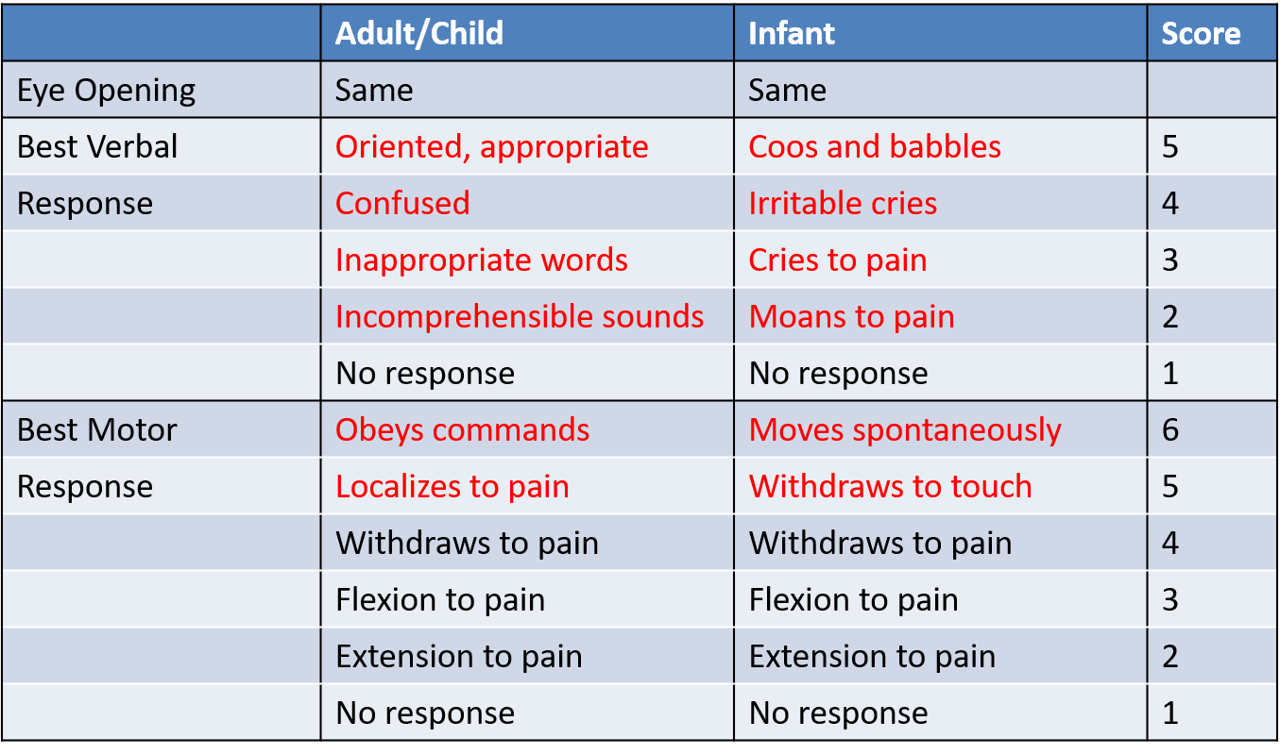
Glasgow Coma Scale

Slide 8
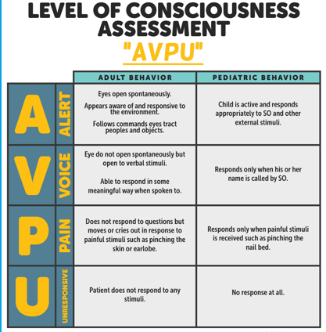

Slide 9
Case 1
14 month old girl, URI symptoms and fever 101. Parents called 911 because she suddenly became “unresponsive and jerking all over”
EMS arrives on scene: she is now sitting on Mom’s lap, crying. Mom says it lasted “about 10 minutes” and she is “back to herself”

Slide 10
Febrile Seizures
2-5% of all children
Seizure occurring at 6 months to 5 years associated with fever
Simple febrile seizure (85%):
Generalized, once over 24 hours, less than 15 minutes
Recommend MD evaluation for first time febrile seizure, even if back to baseline
If history of febrile seizure, may be able to stay home
Complex febrile seizure (15%):
Focal, recur within 24 hours, greater than 15 minutes
ED observation at least 2 hours

Slide 11
What do I tell a parent?
Watch the time
Do not hold the child still or restrain them.
Make sure they are lying safe on floor or bed. Move things that could be of danger.
Turn child on side.
Put something under their head like a sweater or jacket.
DO NOT put anything in their mouths or between their teeth.
Loosen tight clothing around the neck.

Slide 12
Case 1.a
14 month old girl, URI symptoms and fever 101. Parents called EMS because she suddenly became “unresponsive and jerking all over”
EMS arrives on scene. Child on floor, rhythmic symmetric jerking of arms and legs with head turned to left, eyes open and blinking, saliva and foaming at mouth. It has been 15 minutes since EMS Call.
https://www.youtube.com/watch?v=BAsRMbTtsTE

Slide 14
Case 1a: what do you do next?
Give midazolam, 0.2mg/kg IM
Check blood glucose
Open airway, suction mouth, give oxygen
Start an IV

Slide 15
Case 1.a: what do you do next?
Give midazolam, 0.2mg/kg IM
Check blood glucose
Open airway, suction mouth, check pulse ox, give oxygen
Start an IV

Slide 16
Assessing respiratory status in someone during or after a seizure
Chest rise and fall
Respiratory rate
Respiratory effort
Breath sounds
Additional airway sounds (snoring)

Slide 17
How can a seizure affect airway?
Airway obstruction from muscle contractions during seizure
Gag reflex suppressed during seizure → aspiration/vomit
Airway obstruction from loss of muscle control
Loss of respiratory drive

Slide 18
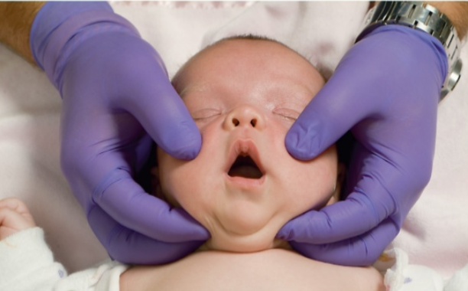
Airway/breathing interventions in seizure
If vomiting, turn on side
Monitor the airway during, after seizure
Jaw thrust, reposition body/head, blanket roll, bag mask ventilation

Slide 20
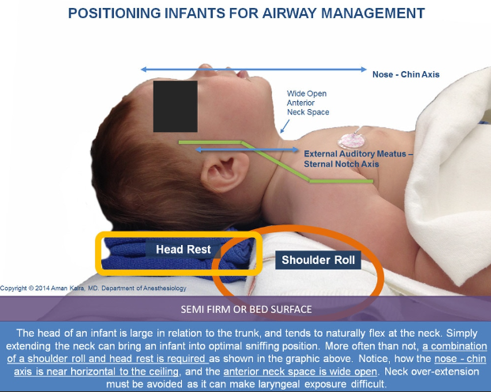

Slide 22
Case 2: new onset, non febrile
4 year old male, no recent illness or history of seizure. Call for unresponsive, abnormal movements of all extremities.
EMS arrives. Positions airway, gives O2, has spontaneous respirations, but continued to be seizing. Parent reports has been ongoing for about 10 minutes.
https://www.youtube.com/watch?v=x9ElVLPSPQM&feature=player_embedded

Slide 24
No IV Access
Diazepam 0.5mg/kg (max 20mg) per rectum
Midazolam 0.2mg/kg (max 7mg) IM
Midazolam 0.2mg/kg (max 10mg) intranasally
→unless known seizure patient with different medication in seizure plan

Slide 25
Child with known seizure disorder
Parents often experts in child’s medical history and needs
May have recommendations for rescue medications different than typical
Underlying disease may affect baseline neurologic exam, risk for status epilepticus, other emergent needs
Brain tumor, other space-occupying lesion
Metabolic disorders
Respiratory or airway disease
Ketogenic diet

Slide 26
Case 2, part 2
4 year old male, no recent illness or history of seizure. Call for unresponsive, rhythmic jerking/shaking of all extremities.
Give IM midazolam, and seizure activity stops. Patient eyes closed, unresponsive to voice but withdraws to pain. Limp extremities and breathing spontaneously.
https://www.youtube.com/watch?v=Uyx65dqm33M

Slide 28
Post ictal period
May last minutes to hours
Concerning if >20 minutes, especially in new onset seizure patient
Staring, not answering questions, confusion, fatigue, weakness or paralysis in one limb, temporary vision or other sensory loss
May be confused, combative, altered mental status, respiratory depression
Requires ongoing monitoring in hospital setting

Slide 29
Post AED effects
Drugs used to stop seizures can alter mental status, cause respiratory depression
Any child receiving rescue seizure medications should be evaluated by MD

Slide 30
Case 3:
18 month old female. Parents report she suddenly became unresponsive, then rhythmic jerking of arms/legs.
EMS arrives 8 minutes later. Eyes are closed, but arms/legs still. Give oxygen and obtain VS. Gathering history and then she starts to have lip smacking, eye deviation to right, left arm flexing.

Slide 31
Status epilepticus
Seizure lasts longer than 5- minutes
Seizure that recurs before patient regains consciousness
Life threatening; can lead to brain damage, hypoxia, hypercapnia, pulmonary edema, hypoglycemia, metabolic acidosis
When present, increased likelihood of underlying pathology

Slide 32
Medication management for status epilepticus
FIRST LINE: Short acting benzodiazepine
Midazolam (IM or IN), diazepam
Ativan (0.1mg/kg IV, max 4mg, give 2mg/min)
Seizure continues for 5 minutes or recurs 5 minutes after first dose
Repeat benzodiazepine
SECOND LINE: seizure continues for 5 minutes after 2nd dose of FIRST LINE → give first dose of SECOND LINE Medication
No history of epilepsy: >2 months old is Fosphenytoin (20mg/kg IV); <2 months old is phenobarbital (20mg/kg)
THIRD LINE: Keppra, valproic acid, lacosamide

Slide 33
Case 4: neonatal seizure
2 week old, parents call 911 for infant seems sleepier, fussy, some “abnormal movements”
EMS arrival: infant with normal HR, RR. Eyes open and looks around, but frequent jerks of head to side with bicycling/tremor of arms and legs. Lasts 10-15 seconds then will stop. Also making spontaneous movements of all extremities. Seems fussy/irritable. Fontenelle is full.
https://www.youtube.com/watch?v=I0gJyYQM9yE
https://www.youtube.com/watch?v=gbryS0aIqOc

Slide 36
Causes of seizures
Fever
Epilepsy
Hypoglycemia
Hypoxia
Head injury
Infection (meningitis, encephalitis)
Poisoning, intoxication, ingestion
Brain tumor or other mass/space-occupying lesion
Stroke (hemorrhagic > ischemic)

Slide 37
Trauma from physical abuse: red flags not to miss
TEN-4 rule:
Torso, ears, neck; if bruised, predict abuse in children under age 4
ANY bruise in child under 4 months
Pattern injuries
“battle sign”, finger or hand prints, circular burns
Abusive head trauma
Often subtle: mild lethargy, vomiting w/o diarrhea, subconjunctival hemorrhage
Sudden cardiac arrest, unresponsive infant, seizures

Slide 38
Important things for EMS to observe and report | Sample questions to ask
Duration of seizure(s) | How long did the seizure last?
Number of seizures patient had, time length between seizures | Was there more than one seizure? If yes, how long did each last and time between?
Describe motor changes during seizure. Level of alertness/consciousness present. | What did the patient do during the seizure? Did the whole body, or just one part of the body shake? Were there any mouth movements or vocalizations? Did the patient stare into space? Was the patient ever responsive?
Note what patient was doing before the seizure including any recent illness, behavior change, trauma, etc. | What was patient doing before the seizure, any symptoms present before seizure?
Post ictal period: symptoms and location can be clues to understanding seizure origins | What did patient do after seizure?

Slide 39
Pediatric Neuro Exam Pearls
Look to parents for cues
“not acting like themselves”
0-2 months: very immature myelination
Normal verbal: crying, random sounds, consolable
May not be fixing/following, lazy eye still normal; nystagmus always abnormal
Emergencies: abusive head trauma, bacterial meningitis or other infection, metabolic crisis
Red flags at any age: increased sleep, decreased vocalization or feeding, decreased tone

Slide 41
Pediatric Neuro Exam Pearls
2-6 months: improving eye contact and starting to communicate with sounds
Normal verbal: cooing, back-and-forth sounds
Fixing/following, making eye contact
Red flags: head lag at 4 months
6-12 months: sitting, to cruising (9 months) to standing holding hands (12 months)
Red flags: child won’t bear weight on legs; stands but “falls to side”
Hold/grasp objects (6 mos), move from hand to hand (9 mos), pick up and put down (12 mos)
Emergencies: abusive head trauma, infection, brain tumor/increased ICP, hypoglycemia and dehydration, hypoxia

Slide 42
Pediatric Neuro Exam Pearls
1-3 years: curious and mobile, so more likely to “get into things”
Speaking words and phrases, but don’t understand complex instructions; stranger anxious, have parent close and calm if able
Red flags: stumbling/falling after age 18 months; not upset with procedures
Tricks: objects that get kids to make eye contact, follow, if they can be soothed/consoled by parent or favorite toy
Emergencies: toxic ingestion, brain tumor, infection, increased ICP (vomit)
4-6 years: improved speech, motor independence
Typically cooperative, should have typical level of alertness expected in older children/adults
Increasing likelihood of spinal cord injury with head trauma
Often scared, inconsolable at sight of blood or fear of unknown. Reassurance, bandage and cover blood

Slide 43
Responders: when to transport
Almost every seizure call needs evaluation in ED
Any child with neurologic exam abnormalities, anything other than A on AVPU, or parents describe “not acting like themselves”
Any seizures that can stay home?
Known seizure disorder, back to baseline, did not receive AED, but they should call their provider
What about known seizure disorder, got AED, back to baseline?
Parent refusal could be considered
What about febrile seizure, simple, no AED and back to baseline?
Still recommend MD evaluation; especially <12 months or first seizure

